Slide 1

Skills for Success with Microsoft Office 365 Volume 1
First Edition
Chapter 2
Insert Summary Functions and Create Charts
Copyright © 2020 Pearson, Inc. All Rights Reserved.
Notes:
If this PowerPoint presentation contains mathematical equations, you may need to check that your computer has the following installed:
1) MathType Plugin
2) Math Player (free versions available)
3) NVDA Reader (free versions available)
Skills for Success with Microsoft Office 365 Volume 1

Slide 2
Skills (1 of 2)
Align and Wrap Text
Apply Absolute Cell References
Format Numbers
Insert the Average Function
Insert the MIN and MAX functions
Notes:
The skills of this chapter are:
Align and Wrap Text
Apply Absolute Cell References
Format Numbers
Insert the AVERAGE Function
Insert the MIN and MAX functions
The skills continue on the next slide.

Slide 3
Skills (2 of 2)
Create and Format Column Charts
Create and Format Line Charts
Create and Format Pie Charts
Update Charts and Insert WordArt
Change Print Settings and Print Workbooks
Notes:
Additional skills include:
Create and Format Column Charts
Create and Format Line Charts
Create and Format Pie Charts
Update Charts and Insert WordArt
Change Print Settings and Print Workbooks

Slide 4
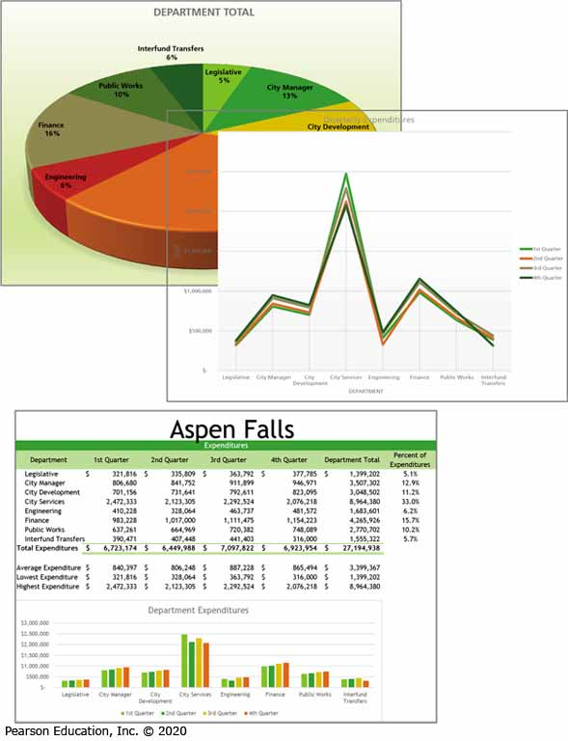

Introduction
Notes:
Once you go through the skills in this chapter, you will be able to create spreadsheets and charts like the ones shown here.

Slide 5
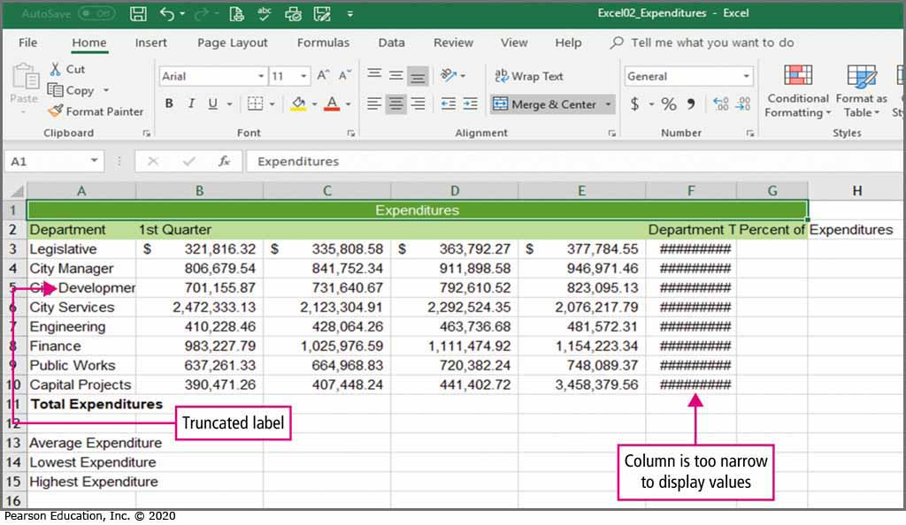
Skill 1: Align and Wrap Text (1 of 4)
Notes:
In cell A5, we see a truncated label. The value in cell A5 is currently wider than the width of column C. The value is truncated because there is a value in cell B5. The values in column F are being replaced by hash marks indicating that the column is currently too narrow to display the values as formatted.

Slide 6
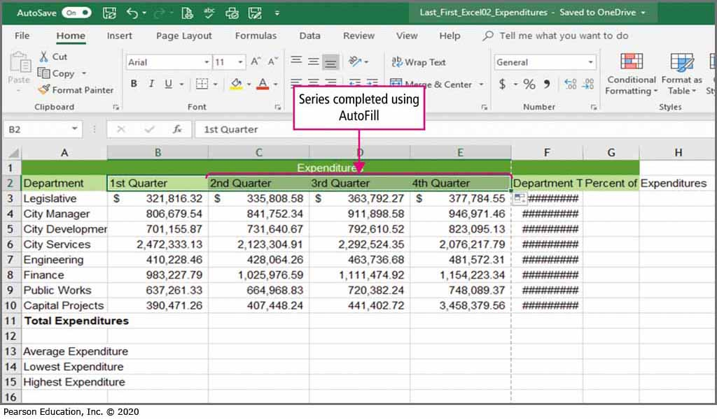
Skill 1: Align and Wrap Text (2 of 4)
Notes:
A series is a group of numbers, text, dates, or time periods that come one after another in succession. A series is shown in cells B2, C2, D2, and E2.

Slide 7
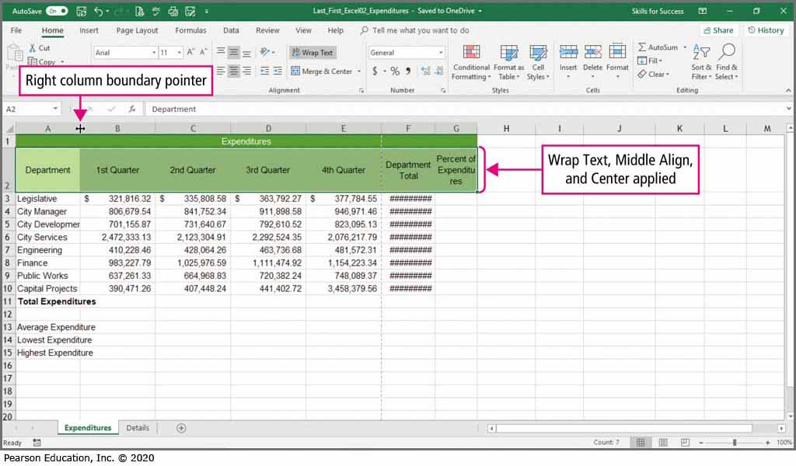
Skill 1: Align and Wrap Text (3 of 4)
Notes:
Excel’s text wrap feature allows text to appear on multiple lines within a cell. This can be very useful in the creation of column headings.

Slide 8
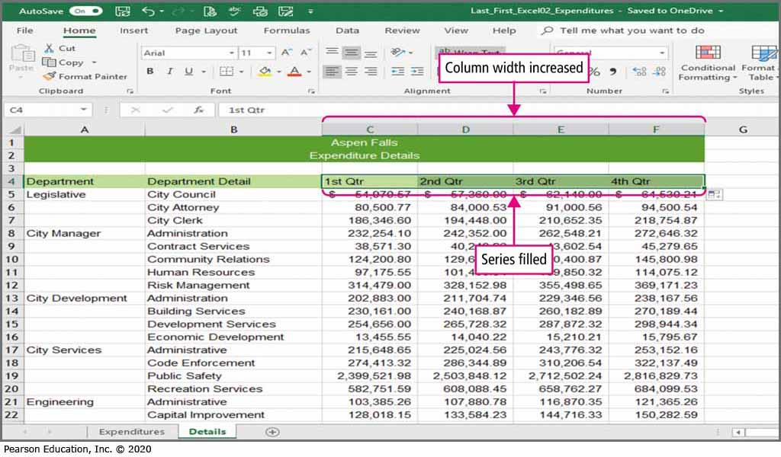
Skill 1: Align and Wrap Text (4 of 4)
Notes:
Excel’s AutoFit feature allows the user to set the column width to accommodate the longest entry in the column.

Slide 9
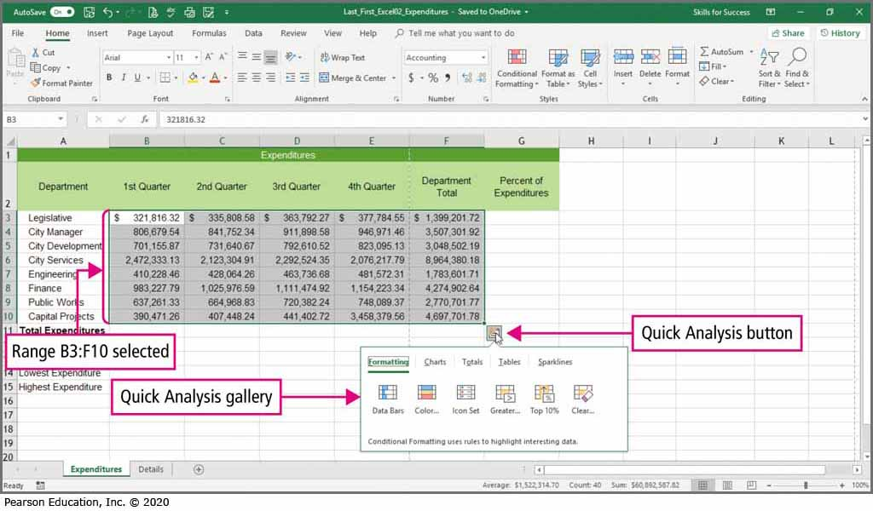
Skill 2: Apply Absolute Cell References (1 of 4)
Notes:
The Quick Analysis button is used to apply conditional formatting or to insert charts and totals.

Slide 10
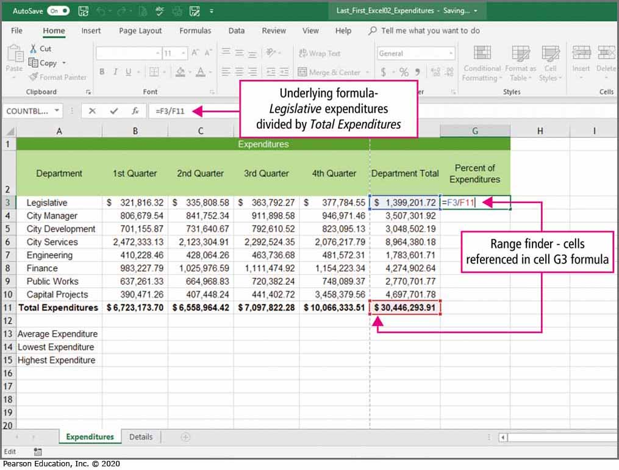
Skill 2: Apply Absolute Cell References (2 of 4)
Notes:
The range finder outlines all cells used in a formula. This can be useful when verifying which cells are used in a formula and for editing formulas.

Slide 11
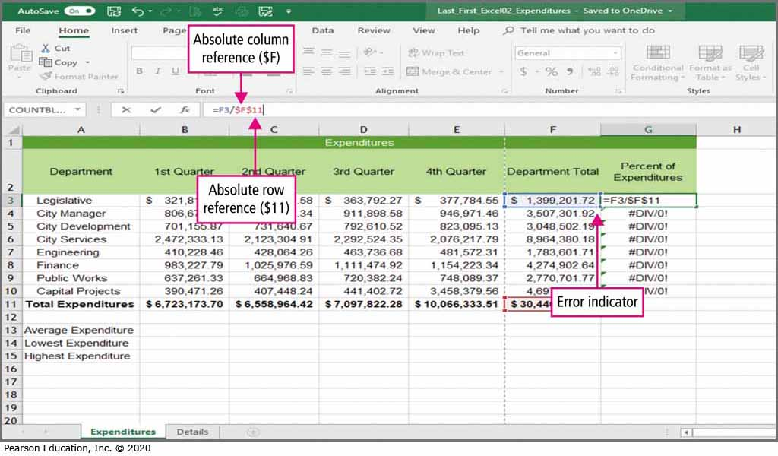
Skill 2: Apply Absolute Cell References (3 of 4)
Notes:
An absolute cell reference does not change when it is copied or filled to other cells. When an Excel formula breaks a rule, a green triangle known as the error indicator is displayed in the cell. Error values appear when a function cannot carry out the calculations in the formula. #DIV/0 indicates the formula is attempting to divide by zero.

Slide 12
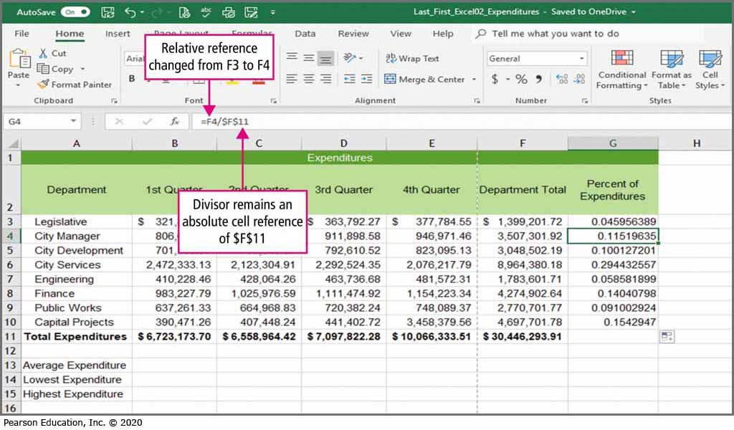
Skill 2: Apply Absolute Cell References (4 of 4)
Notes:
Notice that the cell reference $F$11 in the formula bar did not changed after the formula was copied.

Slide 13
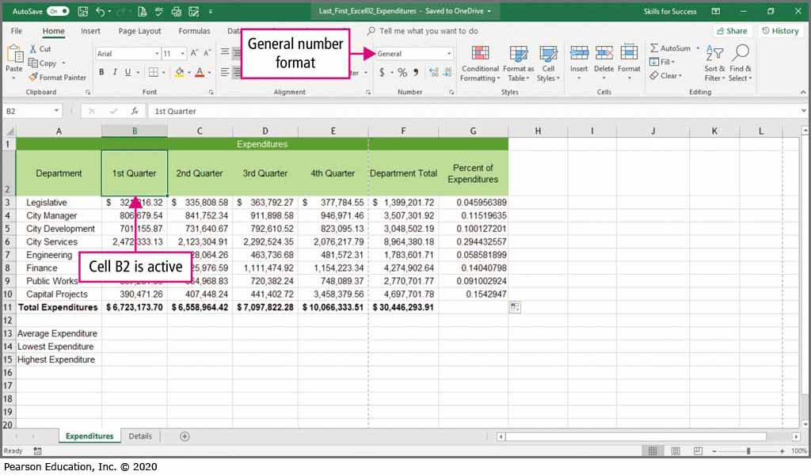
Skill 3: Format Numbers (1 of 4)
Notes:
Excel allows you to set the number format for a cell. You can decide how many decimal places to display, whether you want commas in the numbers, and if you want dollar signs to be displayed. Excel defaults to General format with no commas or trailing zeros behind the decimal point.

Slide 14
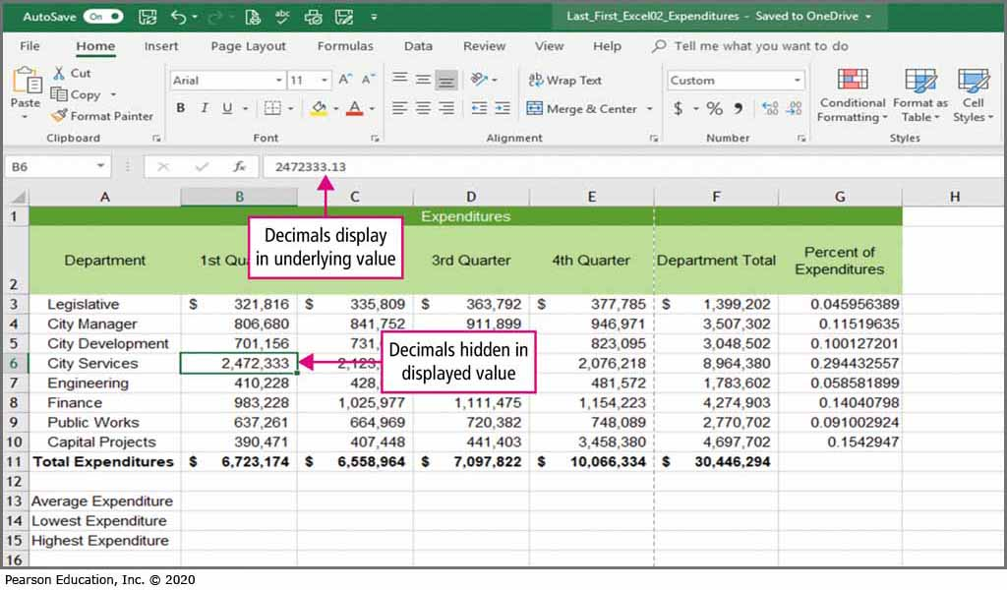
Skill 3: Format Numbers (2 of 4)
Notes:
Formatting the values in a cell only affects the displayed value. The underlying value remains the same regardless of the formatting that is applied.

Slide 15
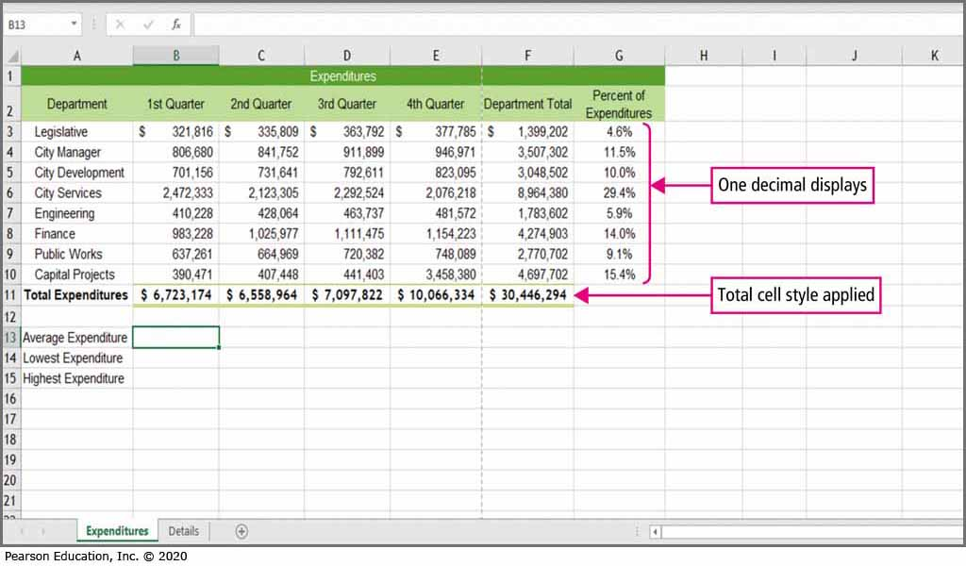
Skill 3: Format Numbers (3 of 4)
Notes:
Worksheet tabs are the labels along the lower border of the workbook window that identify each worksheet. This workbook has two worksheets, the Expenditures and the Details worksheets. The Expenditures worksheet is the active worksheet.

Slide 16
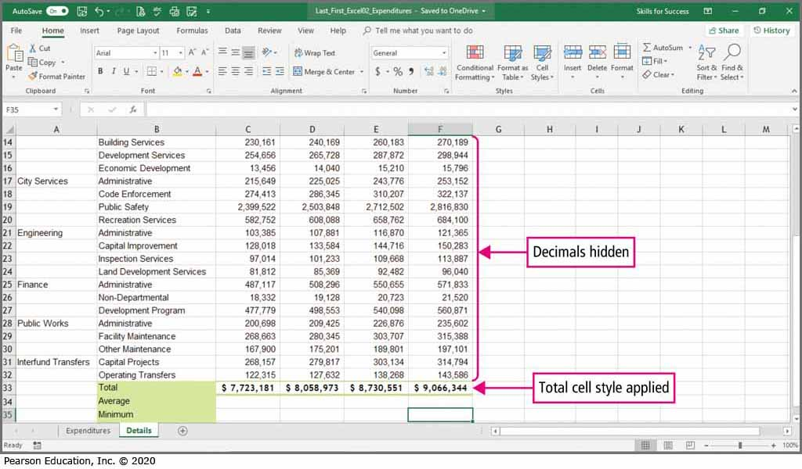
Skill 3: Format Numbers (4 of 4)
Notes:
After clicking the Details tab, the Details worksheet is now the active worksheet.
The Decrease Decimal button can be used to allow fewer places behind the decimal to be displayed.

Slide 17
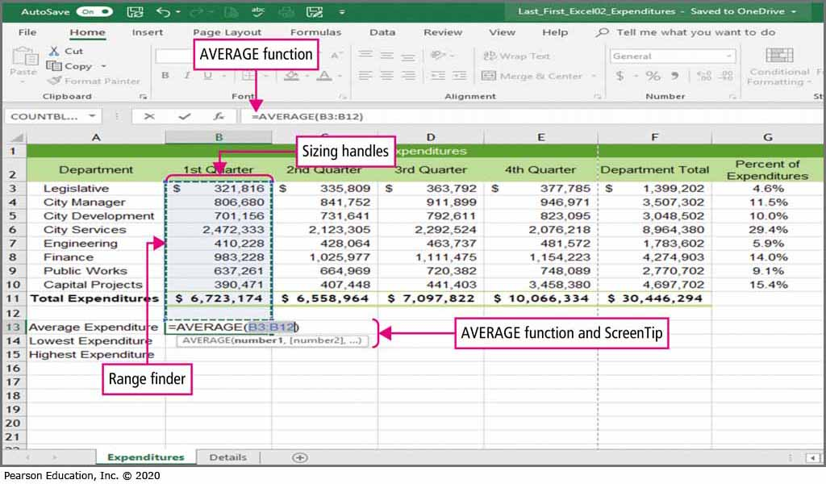
Skill 4: Insert the Average Function (1 of 3)
Notes:
Statistical functions are predefined formulas that describe a collection of data. Some of Excel’s most common statistical functions are Average, Maximum, and Minimum.

Slide 18
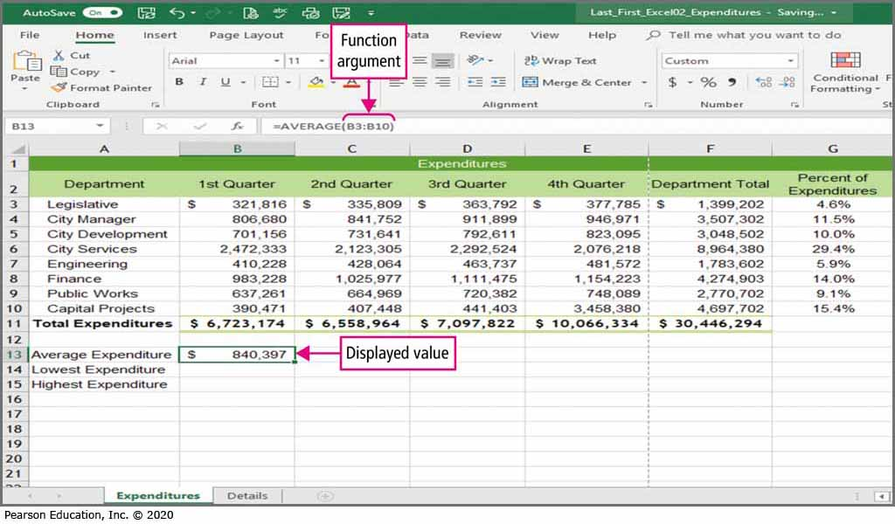
Skill 4: Insert the Average Function (2 of 3)
Notes:
A function’s argument is the value that the function uses to perform operations or calculations. The arguments each function uses are specific to that function. Some arguments include numbers, text, cell references, and range names.

Slide 19
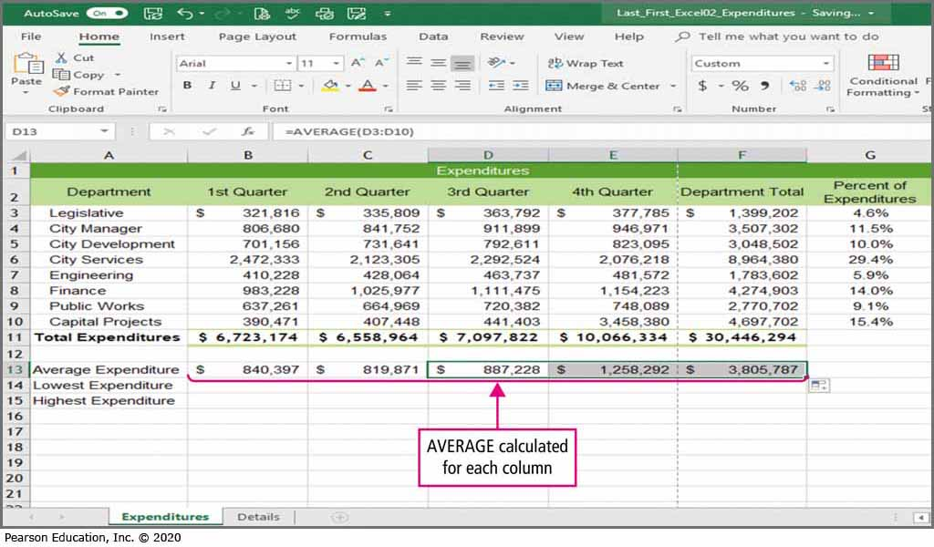
Skill 4: Insert the Average Function (3 of 3)
Notes:
The AVERAGE function adds a group of values and then divides the results by the number of values in the group.

Slide 20
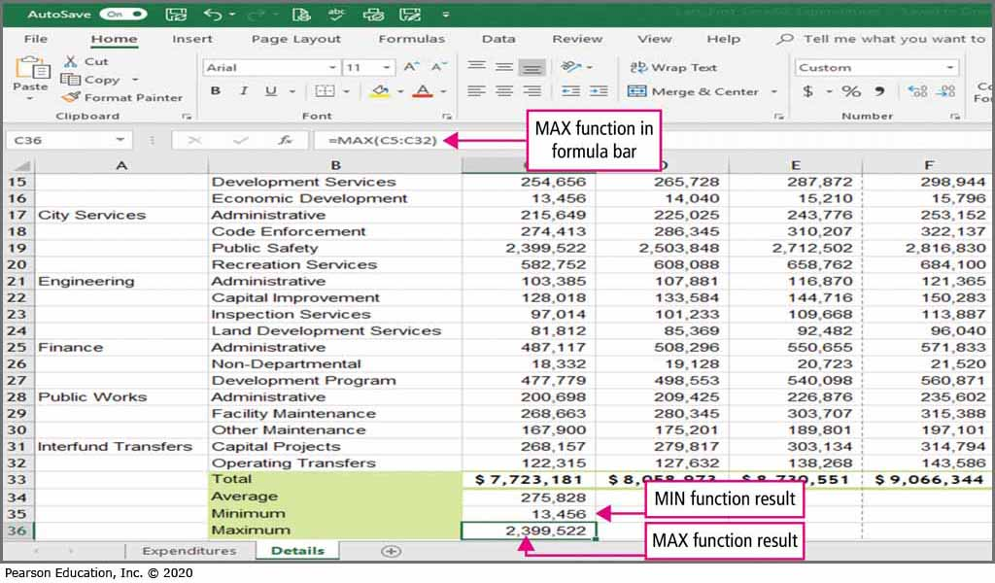
Skill 5: Insert the MIN and MAX Functions (1 of 3)
Notes:
The MIN function returns the smallest value in a range, while the MAX function returns the largest value in a range.

Slide 21
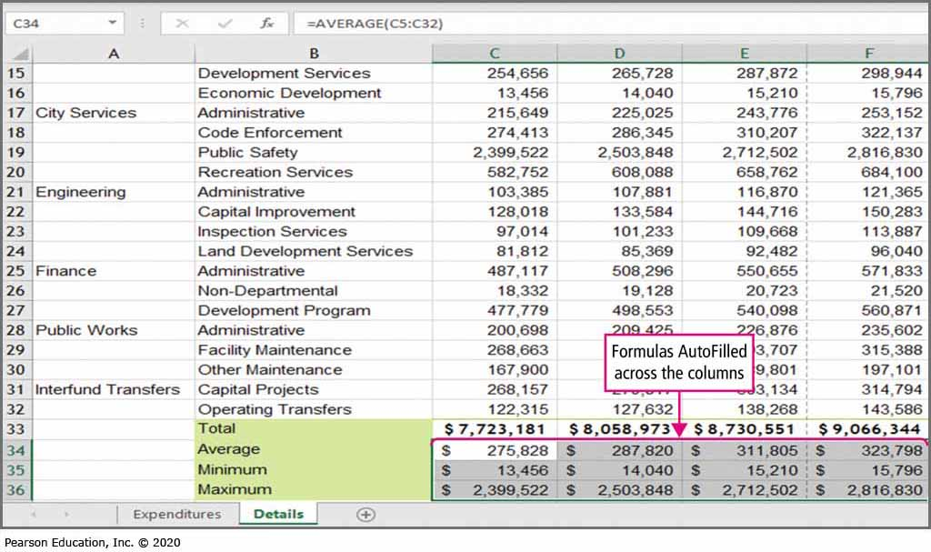
Skill 5: Insert the MIN and MAX Functions (2 of 3)
Notes:
The AutoFill feature is used to copy the formulas across the columns.

Slide 22
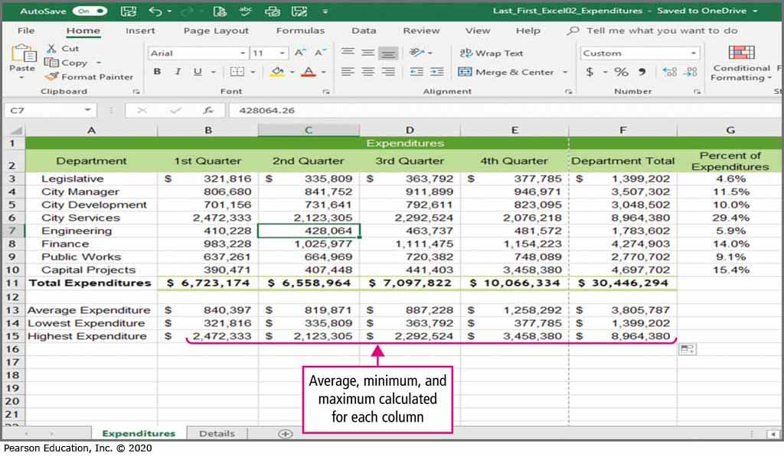
Skill 5: Insert the MIN and MAX Functions (3 of 3)
Notes:
The AVERAGE, MIN, and MAX functions have been applied to columns B through F of the Expenditures worksheet.

Slide 23
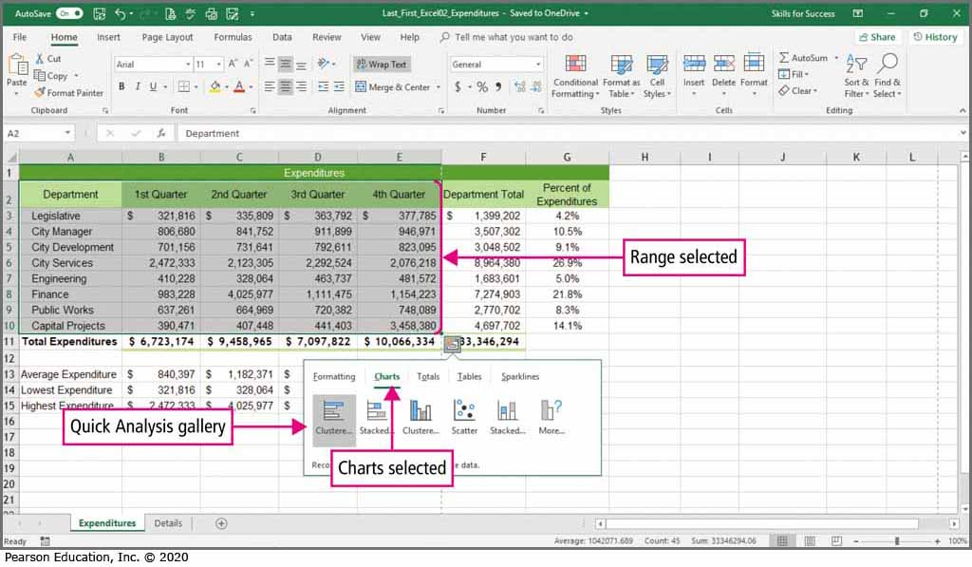
Skill 6: Create and Format Column Charts (1 of 4)
Notes:
A chart is a graphical representation of data used to show comparisons, patterns, and trends. When a range is selected, the Quick Analysis button displays. Click the Quick Analysis button, and then select Charts in the gallery.

Slide 24
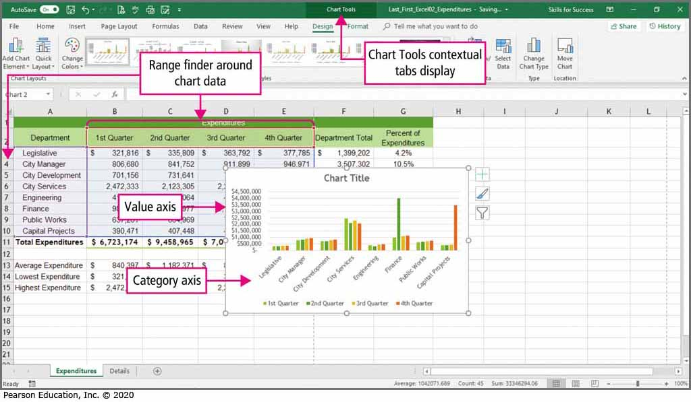
Skill 6: Create and Format Column Charts (2 of 4)
Notes:
A column chart is useful for illustrating comparisons among related numbers. An embedded chart is one that is placed on the worksheet containing the data. The chart on this slide is an embedded chart. An axis is a line bordering the plot area of the chart. The category axis displays the category labels. These labels identify the categories of data. The value axis shows the worksheet’s numeric data. The x-axis is the horizontal axis and the y-axis is the vertical axis.

Slide 25
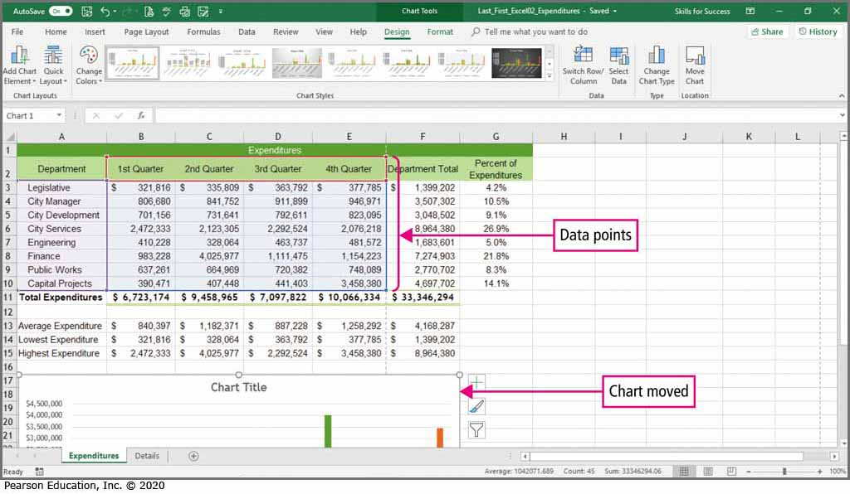
Skill 6: Create and Format Column Charts (3 of 4)
Notes:
A data point is a chart value that originates in a worksheet cell. A data marker represents a single data point. Columns, bars, an area, a dot, a pie slice, or other symbols can serve as data markers. The chart legend identifies the patterns or colors that are assigned to a category in the chart.

Slide 26
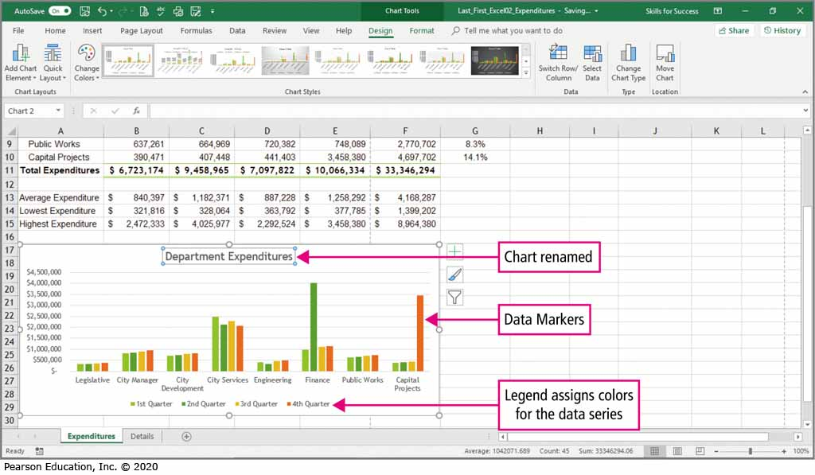
Skill 6: Create and Format Column Charts (4 of 4)
Notes:
You can change the chart name, adjust the data makers, and move or remove the legend of a chart.

Slide 27
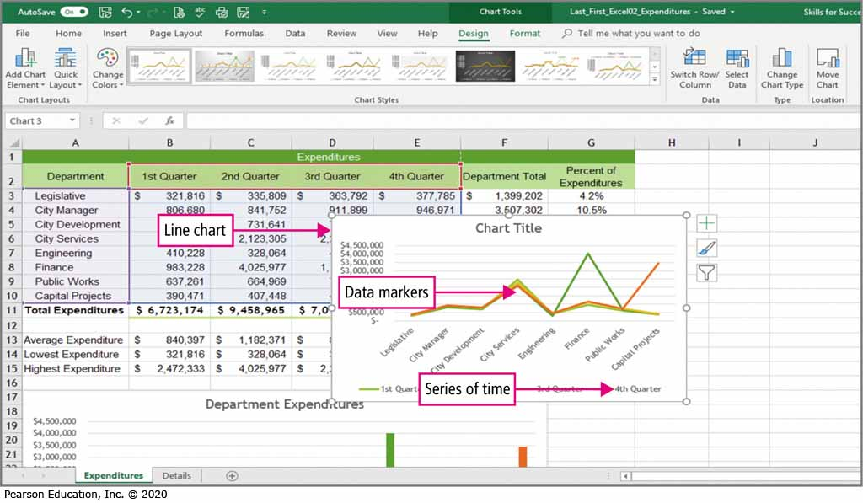
Skill 7: Create and Format Line Charts (1 of 3)
Notes:
A line chart allows you to compare more than one set of values, each group of values is connected by a different line. In this line chart, the years display at the bottom of the chart, and the population growth is represented by the lines on the chart.

Slide 28
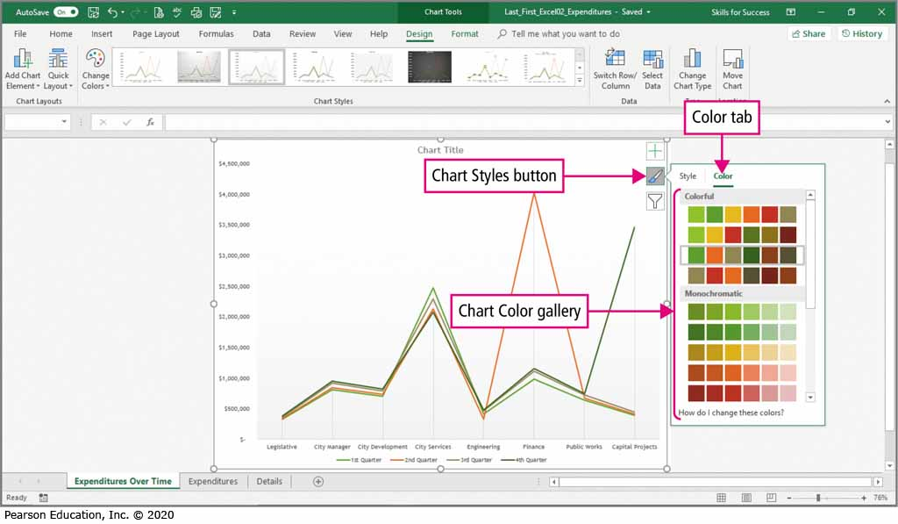
Skill 7: Create and Format Line Charts (2 of 3)
Notes:
A chart style is a prebuilt chart format that applies an overall visual look to a chart by modifying its graphic effects, colors, and backgrounds.
A chart layout is a prebuilt set of chart elements that can include a title, a legend, or labels.

Slide 29
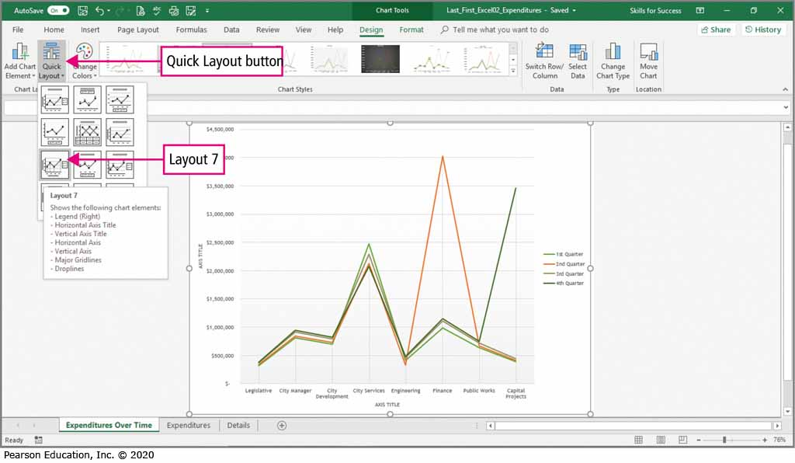
Skill 7: Create and Format Line Charts (3 of 3)
Notes:
When you move a chart to a new sheet, the new sheet is called a chart sheet.

Slide 30
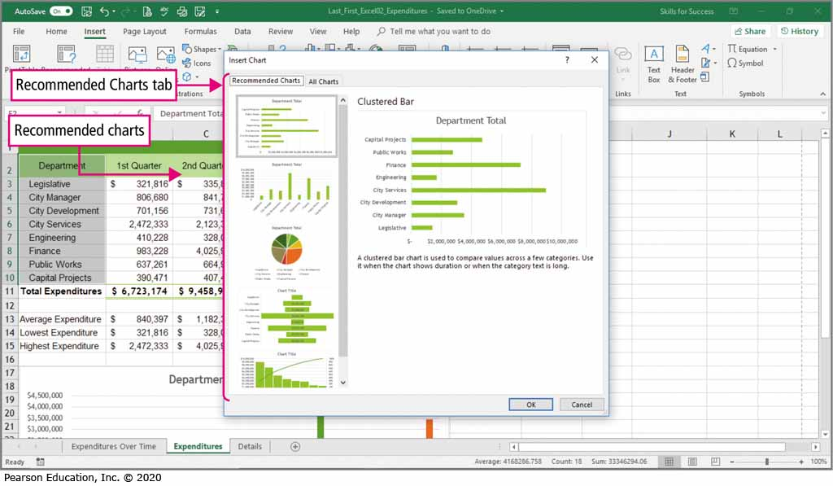
Skill 8: Create and Format Pie Charts (1 of 4)
Notes:
A pie chart is used when you want to display the relationship of parts to a whole. After you have selected the data that you want included in the chart, Excel will recommend charts for that data.

Slide 31
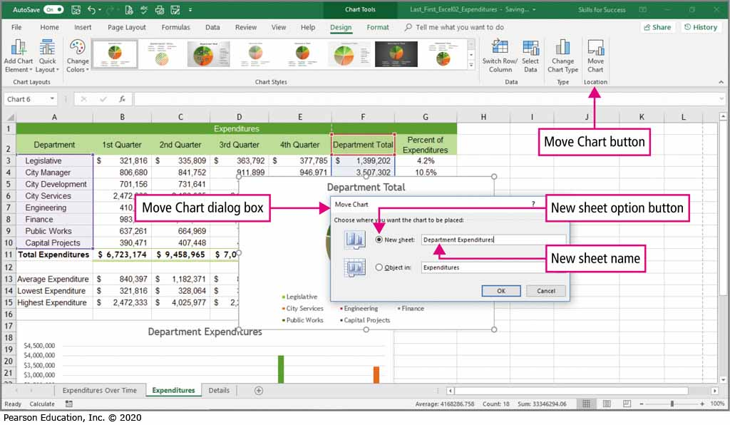
Skill 8: Create and Format Pie Charts (2 of 4)
Notes:
A chart can either be embedded—placed in the worksheet where the data appears—or be placed on a sheet by itself. This sheet is called a chart sheet.

Slide 32
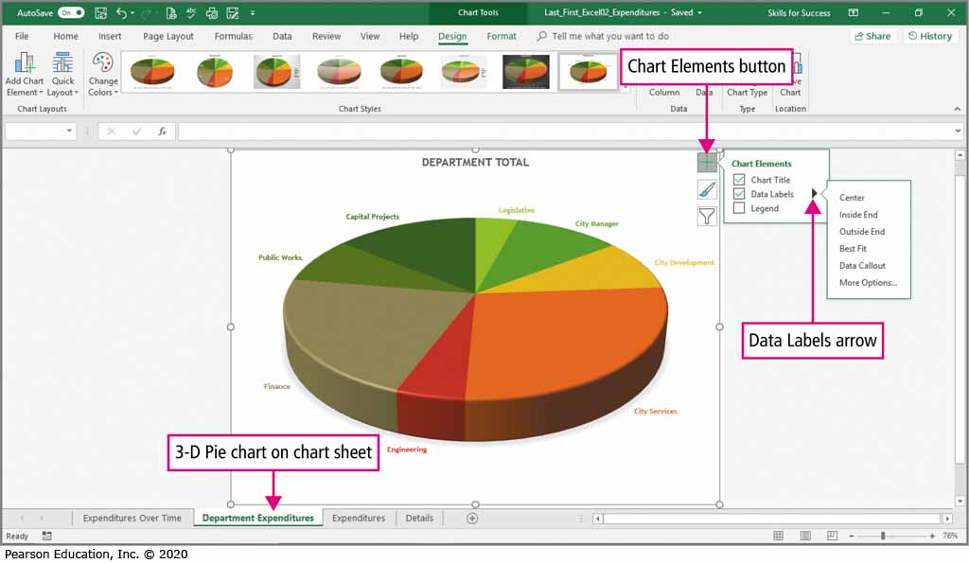
Skill 8: Create and Format Pie Charts (3 of 4)
Notes:
A 3-D or three-dimensional chart is one where the image appears to have all three spatial dimensions—length, width, and depth.

Slide 33
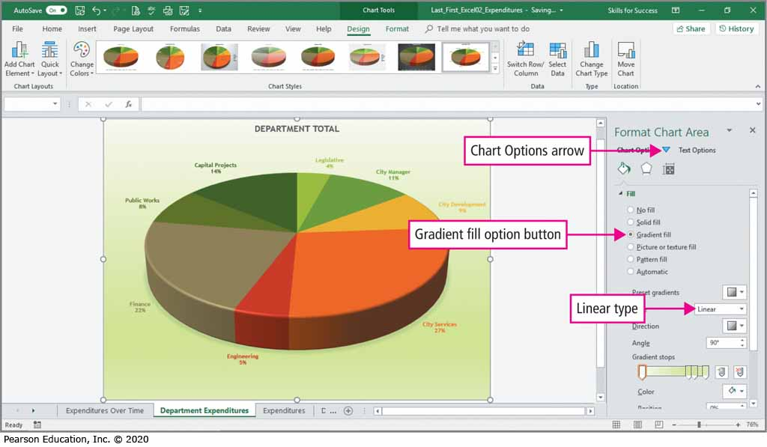
Skill 8: Create and Format Pie Charts (4 of 4)
Notes:
The Format Chart Area allows you to modify the gradient fill and linear type of the chart.

Slide 34
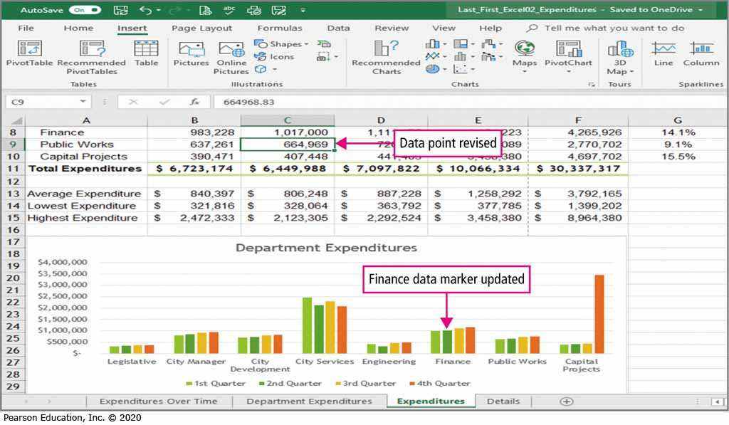
Skill 9: Update Charts and Insert WordArt (1 of 4)
Notes:
A feature of Excel is that when the source data of a chart is changed, the chart is updated to reflect the change.

Slide 35
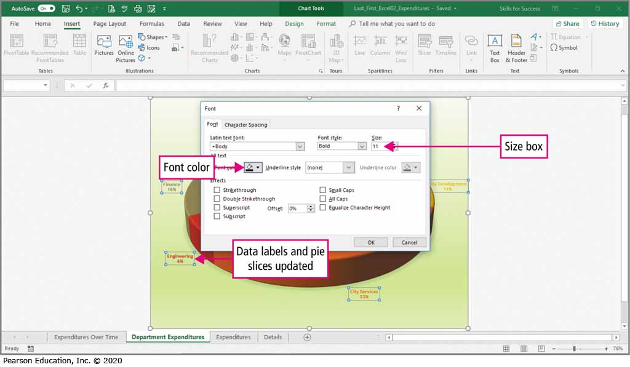
Skill 9: Update Charts and Insert WordArt (2 of 4)
Notes:
This slide shows that the data labels and pie slices have been updated after data in the worksheet was changed.

Slide 36
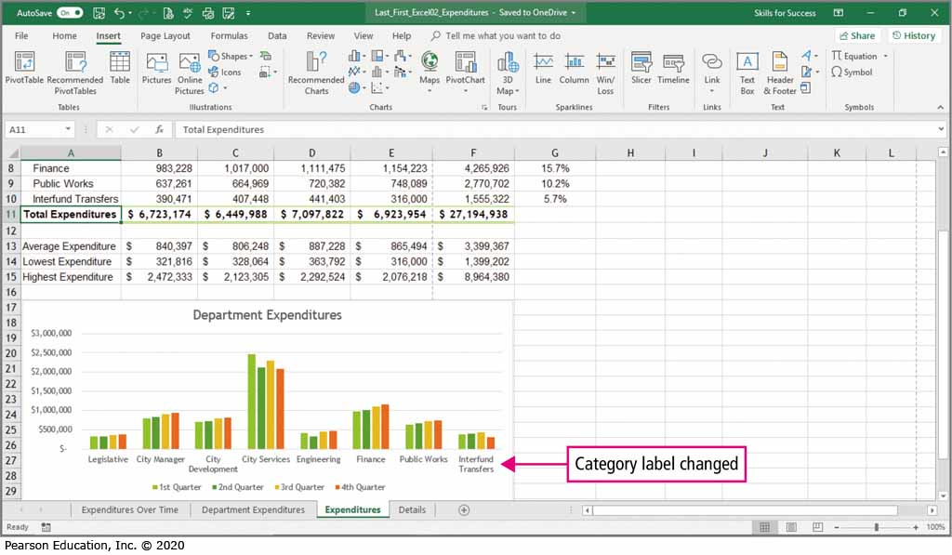
Skill 9: Update Charts and Insert WordArt (3 of 4)
Notes:
Not only are data values updated within the chart, but also category labels when they are changed in the worksheet.

Slide 37
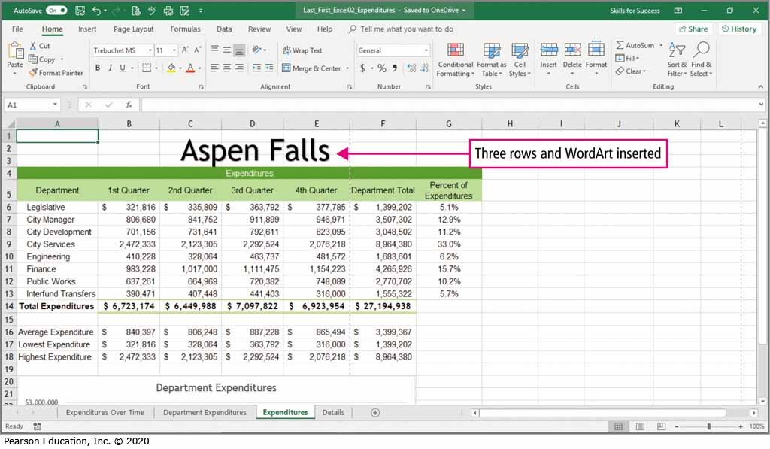
Skill 9: Update Charts and Insert WordArt (4 of 4)
Notes:
WordArt can be inserted into a worksheet, which can be beneficial for creating titles.

Slide 38
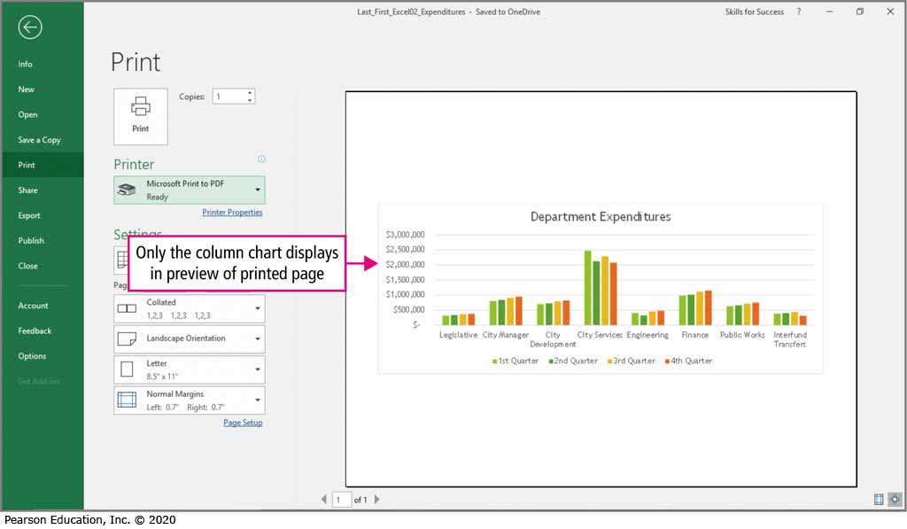
Skill 10: Change Print Settings and Print Workbooks (1 of 3)
Notes:
Excel’s Page Layout view allows you to preview and adjust the printed document.

Slide 39
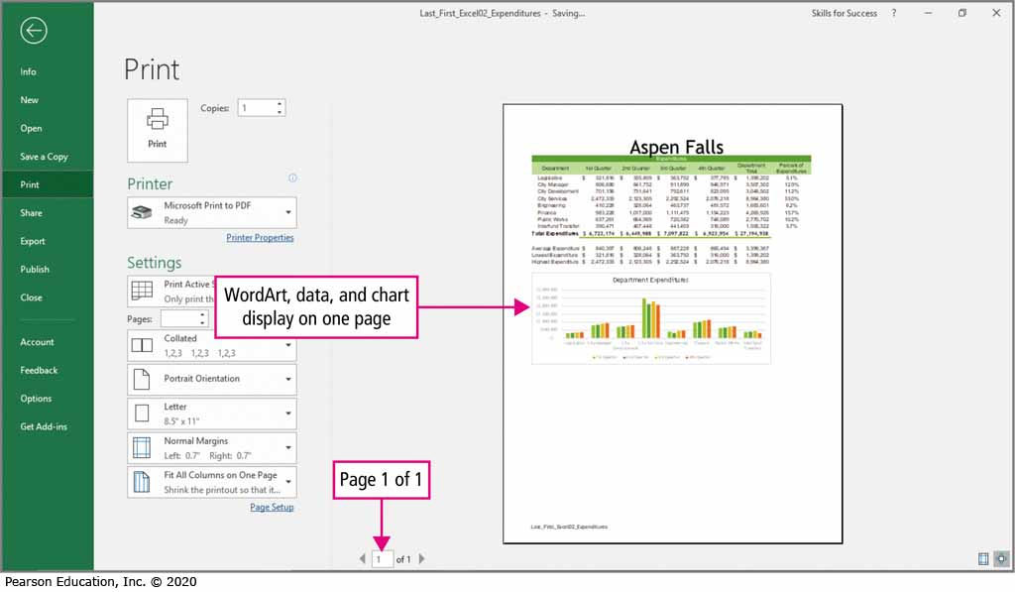
Skill 10: Change Print Settings and Print Workbooks (2 of 3)
Notes:
The Scale to Fit group allows you to fit your worksheet and the chart onto one page.

Slide 40
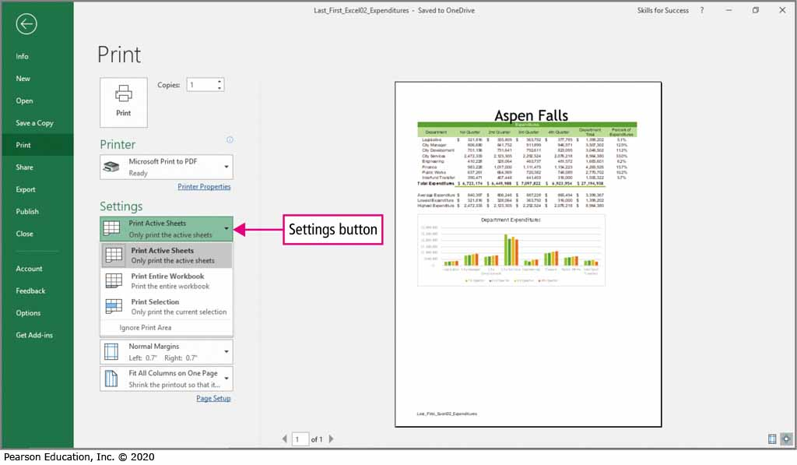
Skill 10: Change Print Settings and Print Workbooks (3 of 3)
Notes:
You can change the print settings to print the active sheet, entire workbook, or just a portion of a worksheet that you select.

Slide 41
More Skills For Success
You will now practice the following additional skills:
Validate Workbooks for Accessibility
Change Chart Types
Create Hierarchy Charts
Create Funnel Charts
Notes:
The following additional skills will be practiced.
Validate Workbooks for Accessibility
Change Chart Types
Create Hierarchy Charts
Create Funnel Charts

Slide 42
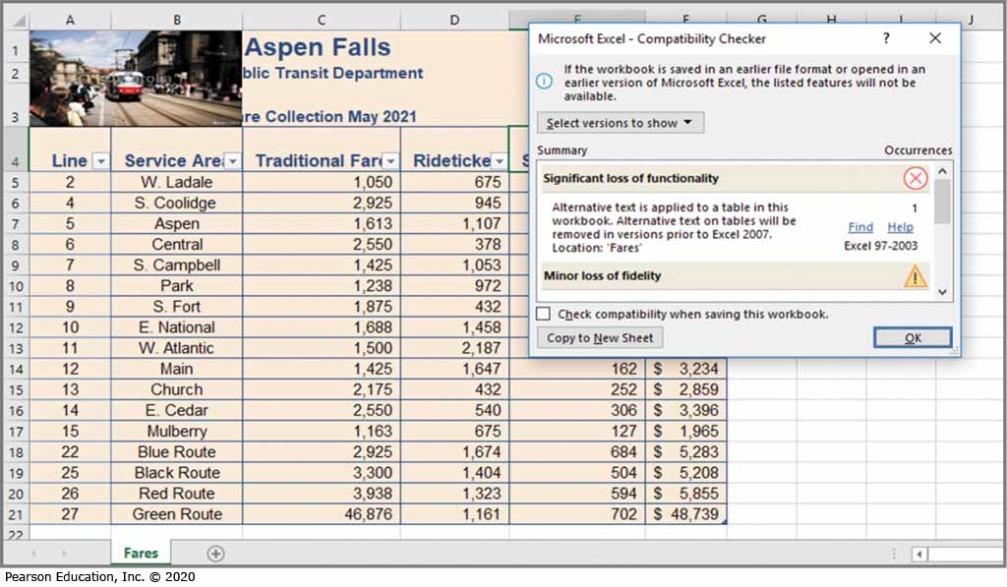
More Skills 11: Validate Workbooks for Accessibility
Notes:
Accessibility is technology that adapts the display for nonvisual users. The Accessibility Checker finds potential accessibility issues and creates a report. Alternative (Alt) text is text used in documents and webpages to provide a text description of an object.

Slide 43
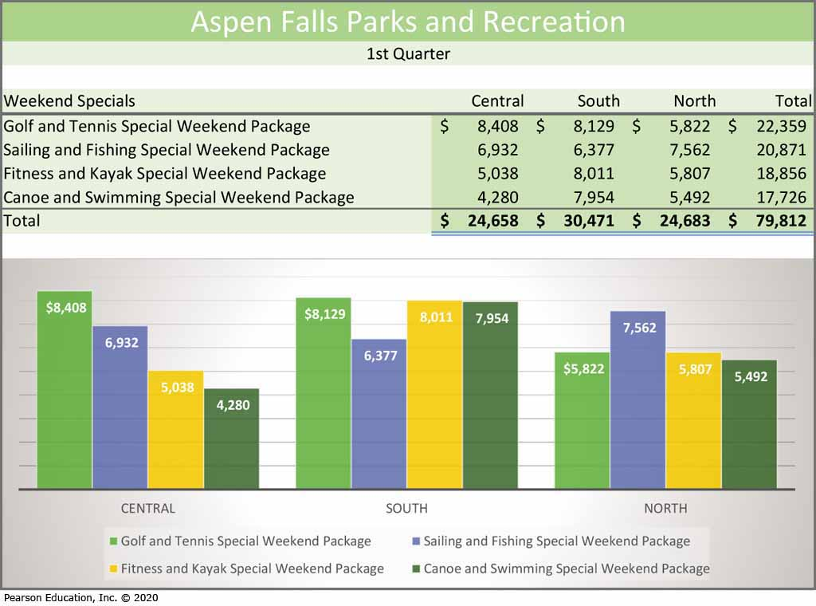
More Skills 12: Change Chart Types
Notes:
You may decide that a different type of chart would be better for displaying your information. Excel allows you to change the type of a chart after it is created. A chart type is a specific design of how data is displayed or compared in a chart. In a bar chart, the categories are displayed on the vertical axis, and the values are displayed on the horizontal axis. A bar chart illustrates comparisons among individual items. In a column chart, the values are displayed on the vertical axis, and the categories are displayed on the horizontal axis.

Slide 44
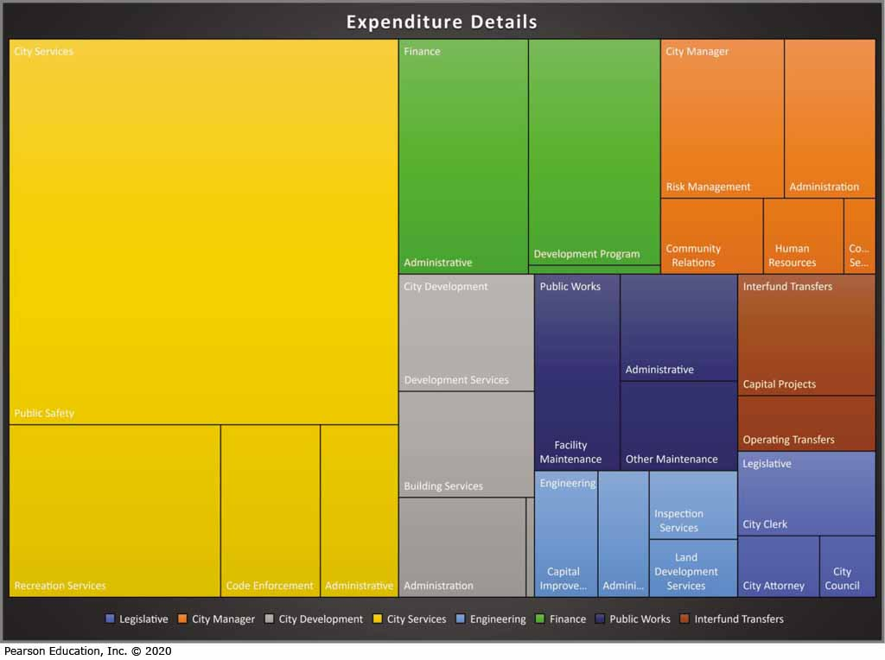
More Skills 13: Create Hierarchy Charts
Notes:
A hierarchy chart is a graphic representation of a series of ordered groupings within a system.
A treemap chart is a type of hierarchy chart that is used to identify patterns of data points.
A sunburst chart is another type of hierarchy chart that is used to show hierarchy through a series of rings.

Slide 45
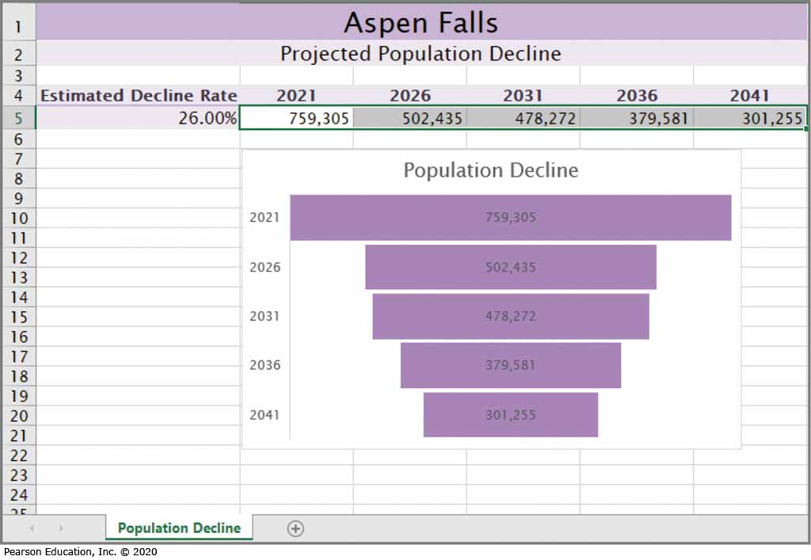
More Skills 14: Create Funnel Charts
Notes:
A funnel chart represents stages in the progressive reduction from one phase to another.

Slide 46
Summary
In this chapter you have learned to:
Absolute cell references
Statistical functions
Charts
Notes:
In this chapter you have learned how to:
Align and Wrap Text
Apply Absolute Cell References
Format Numbers
Insert the AVERAGE, MIN, and MAX Functions
Create and Format Column Charts
Create and Format Pie Charts

Slide 47

Questions
Notes:
As you complete this chapter in Excel, be sure you ask questions. You want to understand the concepts so that you can continue to build on them in future chapters.

Slide 48

Copyright

